Slide 1
June 2, 2022

Slide 2
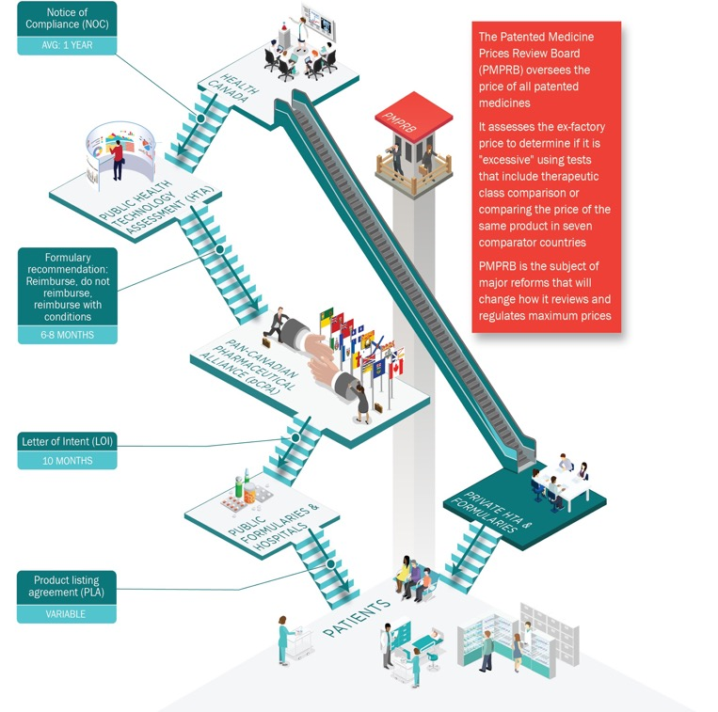
Canadian commercial pathway for medicines is uncertain and long
Since mid-2019, of the 129 medicines approved by FDA, less than half were submitted to Health Canada
Health technology assessments
Restrictive reviews overly focused on pricing
PMPRB
Reform created significant business uncertainty over past 6 years
Damaged Canada’s position in global launch sequencing
pCPA
Long and uncertain process (10 months on average)
Lack of transparency and accountability
Provincial listings
Long and variable from one province to another
Notes:
Canada has a complex review and reimbursement system for new medicines
Right from the start, when we compare to the US, several therapies are simply not launched here. Since mid-2019 of the 129 medicines approved by FDA, less than half were submitted to Health Canada
And for those medicines that are launched here, they face a long and uncertain commercialization pathway
1. PMPRB:
Spent much of the past six years focused on the PMPRB changes, which were detrimental and challenging
The reform created significant business uncertainty and damaged Canada’s position in global launch sequencing
2. HTA
Uncertainty and restrictive reviews at health technology level
Overly focused on pricing
3. pCPA
Long and uncertain timelines at the pan-Canadian Pharmaceutical Alliance – it takes on average 10 months to complete the pCPA process
4. Provincial listings
Variable timelines for listings by the provinces for reimbursement following a pCPA deal
All these different issues have had a compounding effect, which has led to access delays for patients

Slide 3
On average, time from NOC to listing continues to trend upward, taking more than 1.5 years to first listing
(up to September 2021)
Listing Year | 2011 | 2012 | 2013 | 2014 | 2015 | 2016 | 2017 | 2018 | 2019 | 2020 | 2021 | Total
CDR | 18 | 22 | 14 | 23 | 24 | 25 | 16 | 34 | 36 | 13 | 10 | 235
pCODR | 2 | 2 | 10 | 12 | 10 | 7 | 14 | 9 | 21 | 20 | 9 | 116
CADTH submissions with First Listing date up to September 29, 2021 were included. Resubmissions were included in the analysis. pCPA 2nd attempts were condensed. Request for advice, drug plan submissions, and discontinued drugs were excluded. Listing dates in Quebec were not used to calculate time to listing. 17 CDR reviews with time to listing greater than 5 years and 1 CDR review with provincial listing before NOC were excluded. 2 pCODR reviews with time to listing greater than 5 years and 3 pCODR reviews with provincial listing before NOC date were excluded.
Source: IQVIA. Market Access Metrics Database. September 2021
Notes:
As we can see from this slide, we aren’t heading in the right direction
Time to listing is getting longer and longer – it now takes upwards of 1.5 years from NOC to a first listing

Slide 4
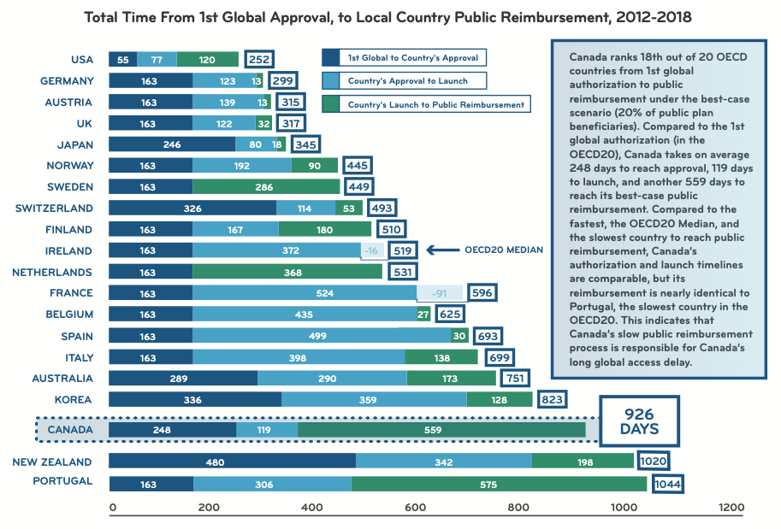
Canada is among the slowest of the OECD20 to reimburse medicines through its public plans
Source: IMC’s Explaining Public Reimbursement Delays for New Medicines for Canadian Patients (Jun. 30, 2020)
http://innovativemedicines.ca/wp-content/uploads/2020/07/CADTH-TTL-8.5x11-EN-Final.pdf
Notes:
This puts Canada way behind its peers
Today, Canada is among the slowest of the OECD20 to reimburse medicines through its public plans – Canada ranks 18th out of 20 countries

Slide 5
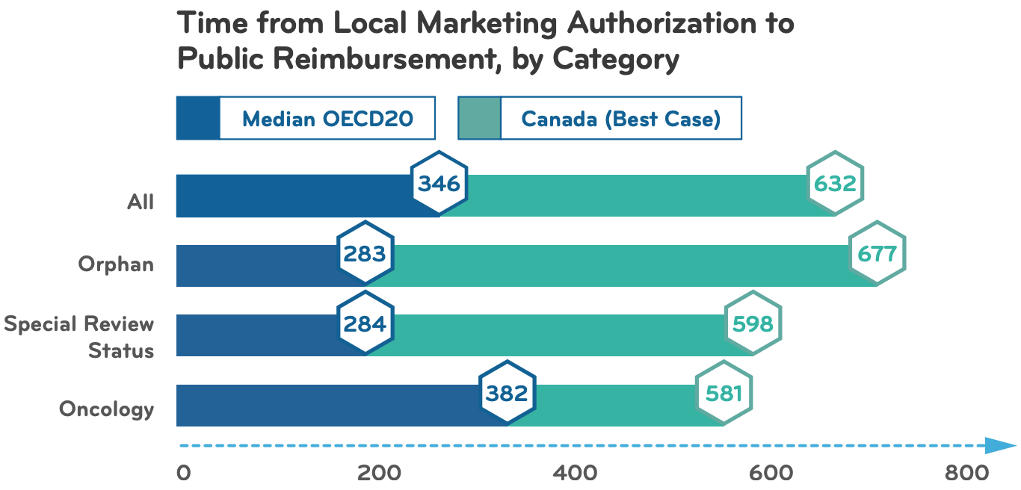
Reimbursement process is much slower than other developed countries
Source: IMC’s Explaining Public Reimbursement Delays for New Medicines for Canadian Patients (Jun. 30, 2020)
http://innovativemedicines.ca/wp-content/uploads/2020/07/CADTH-TTL-8.5x11-EN-Final.pdf

Slide 6
Recent life sciences strategies are the roadmaps to AIM HIGHER to accelerate and improve access to health innovations
2021 federal biomanufacturing and life sciences strategy strives to build Canada’s life sciences sector in response to the COVID-19 crisis, including through “world-class regulation” (Fifth pillar of strategy)
Quebec’s renewed life science strategy’s includes commitment to accelerate access to new medicines
The Ontario government launched a new life sciences strategy aimed at driving economic growth, reducing red tape, and supporting strategic domestic firms and accelerating access to health innovation
Notes:
While these are important challenges, we also have several opportunities that can help us turn the corner
First, the federal government’s decision to remove the most uncertain and problematic aspects of the PMPRB reforms from the regulations is a step in the right direction
Second, we have an opportunity to move forward on multiple life sciences strategies across Canada to improve the policy environment and accelerate and improve access to health innovations
These strategies call for world class regulations and faster access to health innovations, many of which will be developed right here in Ontario and in Canada
Today, IQVIA will present the results of its study on drug launches in Canada
This is an update to a study we commissioned a couple of years ago
You will see that some of the recent trends demonstrate the need for us, as an industry, to continue advocating for a better, faster and more predictable commercial pathway for new medicines to be able to compete with other markets and attract early drug launches
Brad, over to you

Slide 7
New Medicine Launches: Canada in a Global Context
June 2, 2022
Prepared by IQVIA Canada
Real World Solutions Consulting Group

Slide 8
In light of proposed federal pricing reforms, we want to generate evidence on how Canada compares globally in access to new medicines
How does Canada compare to international markets in terms of time to launch, proportion of launches and sequence in launch for new medicines?
Have we seen changes in Canada since the federal policy announcements?

Slide 9
Table of Content
Project Objectives and Approach
Results
Summary

Slide 10
Table of Content
Project Objectives and Approach
Results
Summary

Slide 11
In light of proposed policy changes on pricing and national pharmacare, we examined where Canada stands globally in terms of access to novel pharmaceuticals
Introduction
INTRODUCTION
The topic of Canada’s access to medicines has been hotly debated in the past few years, particularly in light of significant federal proposals for policy changes on pricing pharmaceuticals and national pharmacare
This research was undertaken to set a benchmark of where Canada stood globally in terms of access to novel pharmaceuticals and to examine more recent indicators of change in the availability of new product launches
We took a data-driven approach and leveraged IQVIA’s global launch and sales database (MIDAS®) to understand Canada’s position in global launch sequencing decisions over the last 20 years
KEY QUESTIONS
How does Canada compare to international markets in terms of time to launch, proportion of launches and sequence in launch?
Have we seen changes in Canada in the recent years following these policy announcements?

Slide 12
MIDAS data was used to analyze launch sequencing of new active substances over the last 20 years from 2002-2021
Data Analysis Approach
Data Period
1
20 years: January 1, 2002 to December 31,2021
Top 25 countries by 2021 sales (where data is available)
Launch date by country
New active substances (novel active ingredients launched globally)
Key Metrics
2
Country’s place in launch sequence
Average time to launch by country
Proportion of new active substances launched by country
Time Trends
3
Launches by country over time vs global launches over time

Slide 13
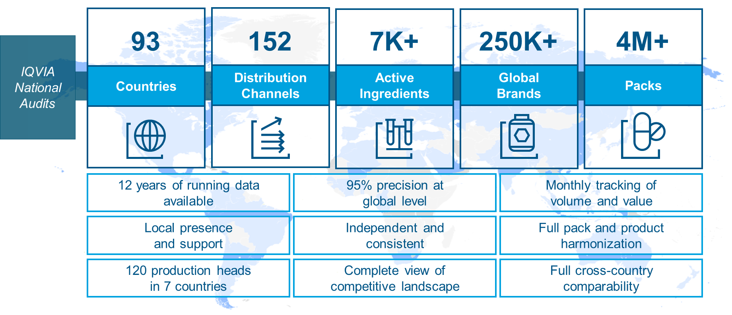
IQVIA MIDAS database is a robust source of worldwide pharmaceutical sales data
MIDAS Database
The trusted industry gold standard in global market measurement
* MIDAS: Multinational Integrated Data Analysis System
Note: Reporting delays by manufacturers may cause observational error in the analysis.

Slide 14
The top 25 countries were identified by global pharma market sales in 2021 and launch date is defined as date of first sales and/or manufacturer launch
Countries & Launch Date
Top 25 Countries by Global Pharma Market Sales in 2021
No.1 | USA | No.14 | RUSSIA
No.2 | CHINA | No.15 | POLAND
No.3 | JAPAN | No.16 | SAUDI ARABIA
No.4 | GERMANY | No.17 | MEXICO
No.5 | FRANCE | No.18 | TURKEY
No.6 | UK | No.19 | SWITZERLAND
No.7 | ITALY | No.20 | BELGIUM
No.8 | SPAIN | No.21 | AUSTRIA*
No.9 | CANADA | No.22 | ARGENTINA
No.10 | BRAZIL | No.23 | SWEDEN*
No.11 | INDIA | No.24 | TAIWAN
No.12 | KOREA | No.25 | THAILAND
No.13 | AUSTRALIA
Definition of Launch Date
Launch Date was defined as: The date from which sales first begin to accumulate AND/OR The date of launch by manufacturer where available Note: Launch date is irrespective of channels (retail or hospital) or payers (public or private)
* Austria and Sweden are not included in the analysis due to launch data quality
Data Source: IQVIA World Review Preview 2022 – Worldwide Pharma Markets

Slide 15
New active substances (NAS) first launched and available globally within 2002-2021 were included
NAS Definition
Inclusion Criteria
Exclusion Criteria
Global first launch at the molecule level in 2002-2021
For use in human therapy
Has been approved by officially recognized governmental bodies (e.g. FDA)
Is commercially available in at least one of these three regions (US, Europe or Canada) and available in more than 1 country
Global first launched branded pharmaceutical
Generics and biosimilars
New indication of existing substance
New combination of existing substance (aka fixed dose combos)
New salt, hydrate, crystalline form, formulation etc. of previously approved substance
Not an active substance (e.g. drug delivery system)
Natural tissue or plant extract with no identifiable therapeutic entity
Blood products, vaccines, or natural health products/vitamins
Products that launched in only ONE country
Products/countries where data not available
New Active Substances (NAS)

Slide 16
Identified NAS were categorized into 12 key therapeutic areas based on first global launch indication to facilitate further subgroup analyses
Therapeutic Areas
Gastrointestinal System
Examples: Antidiabetics (Januvia), IBD (Entyvio), Antiemetic (Aloxi), etc.
Musculo-Skeletal System
Examples: Antirheumatic (Xeljanz), Antigout (Fasturtec), etc.
Blood Coagulation
Examples: Antithrombotic agents (Apixaban), Antidote to anticoagulants (Praxbind), etc.
Nervous System
Examples: Antipsychotic (Abilify), Antimigraine (Aimovig), etc.
Cardiovascular System
Examples: Calcium antagonists (Cleviprex), Diuretics (Vaprisol), etc.
Respiratory System
Examples: Antiasthma (Nucala), COPD (Xolair), etc.
Dermatologicals
Examples: Anti-psoriasis (Taltz), Anti-inflammatory (Dupixent), etc.
Ophthalmic System
Examples: Wet AMD (Lucentis), Antiglaucoma (Vyzulta), etc.
Hormonal Preparations
Examples: Hormonal contraceptives (Ortho Evra), Antigrowth hormone (Signifor), etc.
Oncology
Examples: Checkpoint inhibitor (Keytruda), Anti-VEGF (Avastin), etc.
Systemic Anti-infectives
Examples: Antifungal (Posanol), Antiviral (Harvoni), etc.
Other Immunosuppressants
Examples: Anti-TNF (Cimzia), Selective Immunosuppressant (Benlysta), etc.
Note:
Products with multiple indications were classified based on indication for the first global indication
Drug classes like antiparasitic, diagnostic agents, non-hormonal gynecological drugs etc. were combined under “Other” therapeutic class

Slide 17
Table of Content
Project Objectives and Approach
Results
Summary

Slide 18
This report outlines relevant findings from MIDAS global data analysis for all NAS and relevant subgroups
Project Approach
Analysis Outputs
1
Canada’s Position in Global Launch Sequence
Observed Country Grouping
Proportion and Time to Launch
All New Active Substances Launched Globally
Key Therapeutic Areas in Canada
MIDAS Global Data Analysis
2
Launch Sequence Over Time
Canada's Launch Sequence Over Time
Canada’s Launches vs Global Launches over time

Slide 19
This report outlines relevant findings from MIDAS global data analysis for all NAS and relevant subgroups
Project Approach
Analysis Outputs
1
Canada’s Position in Global Launch Sequence
Observed Country Grouping
Proportion and Time to Launch
All New Active Substances Launched Globally
Key Therapeutic Areas in Canada
MIDAS Global Data Analysis
2
Launch Sequence Over Time
Canada's Launch Sequence Over Time
Global Launch Sequence Over Time

Slide 20
Over the last 20 years, Canada ranked behind UK and Germany on median time to launch and behind six countries regarding number of launches
Country Grouping
20-year Analysis
World’s 2nd largest market, but historically complex & unpredictable regulatory environment
Some common characteristics:
Unrestricted list prices
Large markets
High level of regulatory certainty
Both Canada and Switzerland are comparable:
Unique but fairly harmonized regulatory agencies
Robust private insurance markets
Relatively high list prices
Benchmark
Group 1
Group 2+
IQVIA MIDAS Database, all new launches within Jan 1, 2002 – Dec 31, 2021 (Data extracted on Mar 21, 2022). Top 25 countries based on 2021 sales. Austria and Sweden were excluded due to launch data quality. NAS: New active substance

Slide 21
Canada ranked 4th to launch a new active substance over the last 20 years with a median 1.2 years lag from first global launch
Time to Launch – All NAS
20-year Analysis
IQVIA MIDAS Database, all new launches within Jan 1, 2002 – Dec 31, 2021 (Data extracted on Mar 21, 2022). Top 25 countries based on 2021 sales. Austria and Sweden were excluded due to launch data quality. NAS: New active substance

Slide 22
This report outlines relevant findings from MIDAS global data analysis for all NAS and relevant subgroups
Project Approach
Analysis Outputs
1
Canada’s Position in Global Launch Sequence
Observed Country Grouping
Proportion and Time to Launch
All New Active Substances Launched Globally
Key Therapeutic Areas in Canada
MIDAS Global Data Analysis
2
Launch Sequence Over Time
Canada's Launch Sequence Over Time
Global Launch Sequence Over Time

Slide 23
In 2021, Canada experienced the longest time to launch since 2012, with 2.1 years median time to launch and ranked at 9th compared to other countries
Canada’s Trend Over Time
Year-over-year Analysis
IQVIA MIDAS Database, all new launches within Jan 1, 2002 – Dec 31, 2021 (Data extracted on Mar 21, 2022). Top 25 countries based on 2021 sales. Austria and Sweden were excluded due to launch data quality. NAS: New active substance

Slide 24
Number of annual NAS launches in Canada has declined every year since 2016 and lags behind the global NAS launches
Canada’s Trend Over Time
Year-over-year Analysis
35 new drugs were launched in US in 2021
Number of NAS Launched Globally
Number of NAS Launched in Canada
IQVIA MIDAS Database, all new launches within Jan 1, 2002 – Dec 31, 2021 (Data extracted on Mar 21, 2022). Top 25 countries based on 2021 sales. Austria and Sweden were excluded due to launch data quality. NAS: New active substance

Slide 25
Comparing with top 3 countries, there are fewer NAS launched in Canada within 2 years following the global launch
Canada’s Trend Over Time
Year-over-year Analysis
IQVIA MIDAS Database, all new launches within Jan 1, 2002 – Dec 31, 2021 (Data extracted on Mar 21, 2022). Top 25 countries based on 2021 sales. Austria and Sweden were excluded due to launch data quality. NAS: New active substance

Slide 26
Among 26 NAS launched globally in 2019, 54% of them were not launched in Canada within 2 years
Canada’s Trend Over Time
5 in Oncology
8 in Rare Disease Area*
14 (54%)
out of 26 NAS launched globally in 2019 were not launched in Canada* within 2 years
2 in Nervous System
1 in Other Immunosuppressants
1 in Systemic Anti-infectives
1 in Respiratory System
1 in Cardiovascular System
2 in Hematological Agents
* NAS from all therapeutic areas were grouped into the “Rare Disease Area” group according to FDA Orphan Drug Designations and Approvals Database. Therefore, NAS in rare disease area were double counted in the “Rare Disease Area” group as well as corresponding therapeutic areas.
1 NAS was grouped into “Others” and not listed here.
IQVIA MIDAS Database, all new launches within Jan 1, 2002 – Dec 31, 2021 (Data extracted on Mar 21, 2022). Top 25 countries based on 2021 sales. Austria and Sweden were excluded due to launch data quality. NAS: New active substance

Slide 27
Table of Content
Project Objectives and Approach
Results
Summary

Slide 28
Canada has slipped from its traditional position as a top-priority country for launch, as recent years have seen increasing time to launch and declining NAS launches
NAS Definition
Over the last 20 years
Recent trends
Canada ranked behind UK and Germany on median time to launch and behind six countries regarding number of launches (UK, Germany, Switzerland, France, Italy and Spain)
Canada ranked 4th with a median time to launch of 1.2 years among the top 23 countries between 2002 to 2021
The US remained the benchmark, recording the most launches, and typically being the first to launch over the past 20 years
The median time to launch in Canada increased from 1.0 in 2020 to 2.1 years in 2021, placing Canada 9th in launch sequence in 2021
Number of annual NAS launches in Canada has declined every year since 2016 and lags behind the global NAS launches
Over the past 5 years (2017-2021), Canada had an average of 20 NAS launched annually compared to an average of 34 NAS launched annually at global level
How Canada fares compared to other countries
IQVIA MIDAS Database, all new launches within Jan 1, 2002 – Dec 31, 2021 (Data extracted on Mar 21, 2022). Top 25 countries based on 2021 sales. Austria and Sweden were excluded due to launch data quality. NAS: New active substance

Slide 29
Disclaimer Notice Life Sciences Ontario (LSO) commissioned IQVIA Inc., a global leader in health data and analytics, to examine the commercialization of new medicines in Canada. As such, LSO shall take full responsibility for claims by third parties arising from use and disclosure of the data. IQVIA is not responsible for any reliance by recipients of the data or any analysis thereof. LSO shall hold IQVIA and related parties harmless from such claims, and from any costs IQVIA may incur in protecting its data or other property.

Slide 31
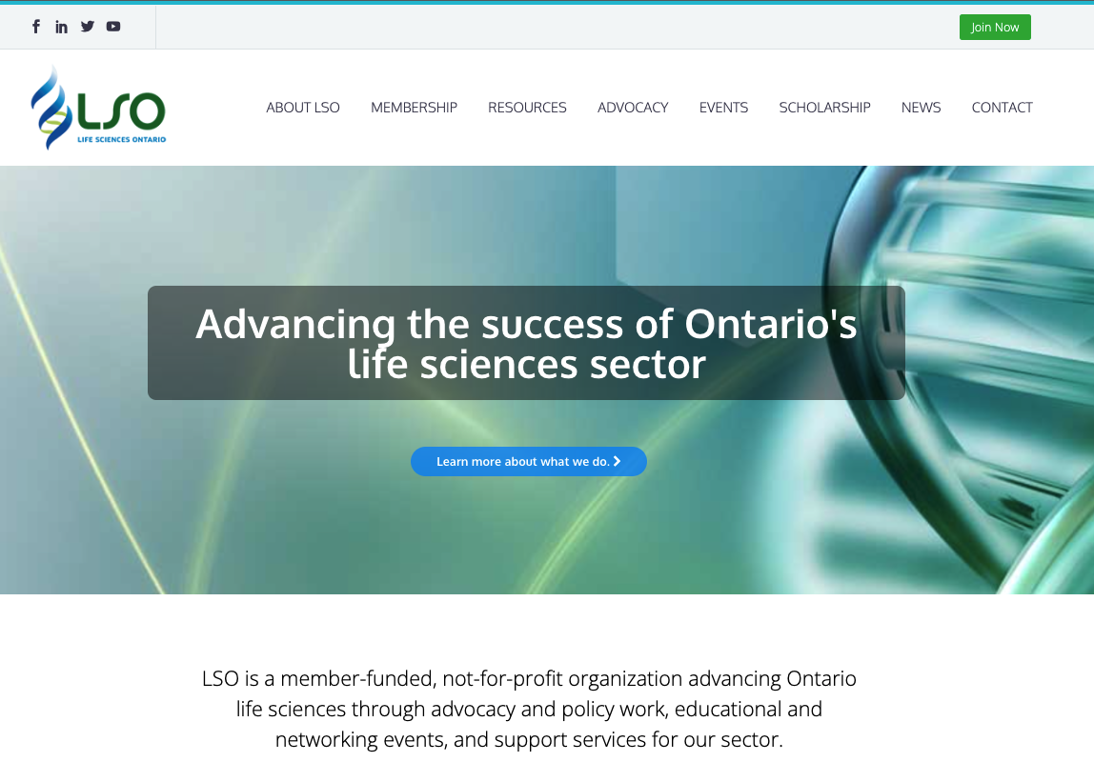
lifesciencesontario.ca
This PowerPoint presentation will be available on LSO’s website and YouTube channel!

